Slide 1
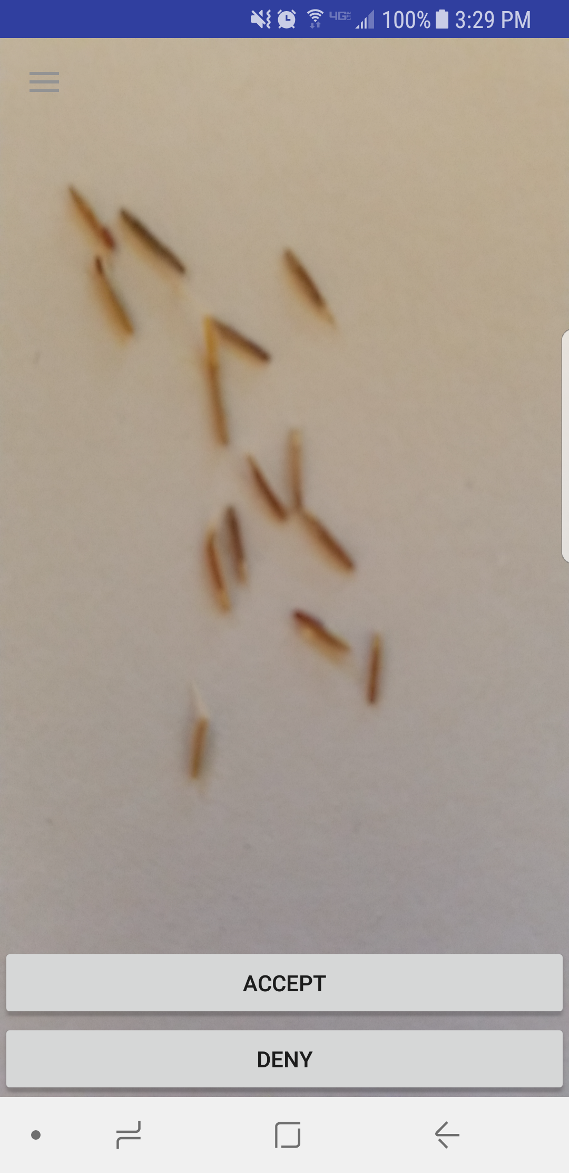
Progress
Server connection established
Camera features added
UI groundwork set

Slide 2
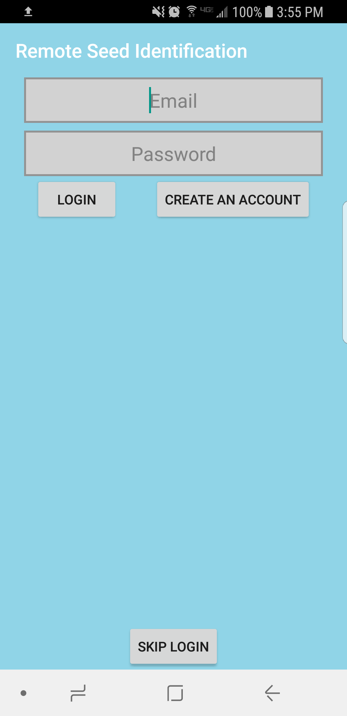
Future Plans
Server error handling
Camera features
UI improvements

Slide 3
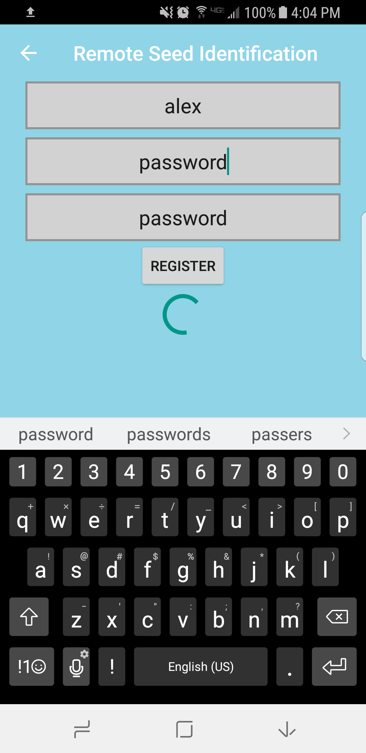
Roadblocks
Establishing socket connection
Handling callbacks from server
Preparing and sending images

